Slide 1

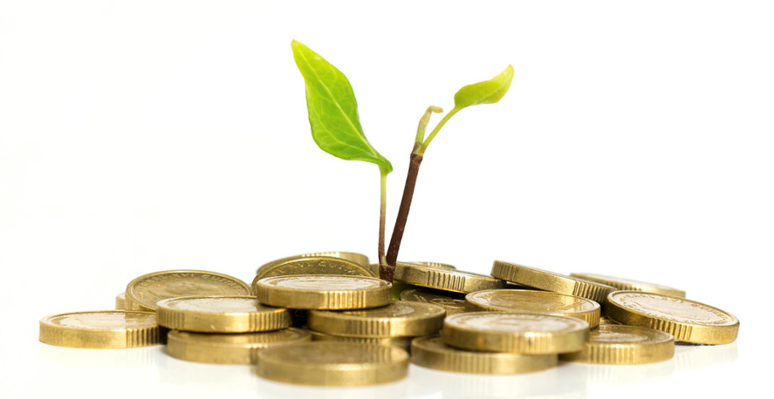
Angel Investing 201:
Assessing Risk in Angel Investing

Slide 2

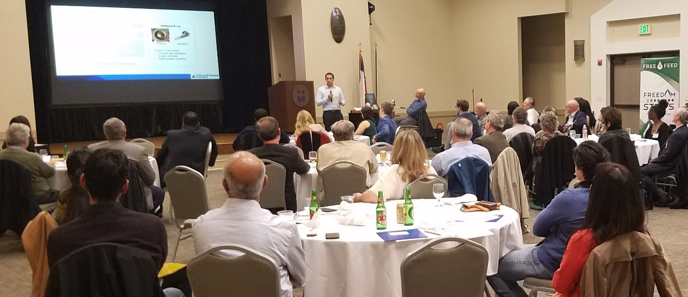
The SWAN Impact Network
About
Focus:
  Social and environmental impact companies
  Primarily US, pre-seed companies
85 angel investors
Chapters in Austin, Dallas and Houston
Also has a Philanthropic sidecar fund
Investments
Have invested $14M in 42 impact companies since 2016
Per year
  ~350 company apply
  ~ 6 companies get initial funding
  ~6 portfolio companies get follow-on funding

Slide 3
Stages of Investing
Pre-seed
Seed
Series A/B/…
External Funding
$0 $x0,000 $x00,000 $xx,000,000 $xx0,000,000
Exits
Bootstrap
Friends
and Family
Angels
Venture
Capital
IPO
Crowd Funding
Strategic
Investors
M&A
Kickstarter
Grants
Private
Equity
Time

Slide 4
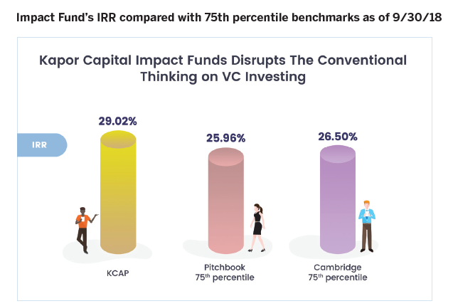
Impact investing provides good returns

Slide 5
Q: What is early-stage angel investing all about?
A: Assessing Risks
Lower risk: investing in Apple or Citi Bank
Higher risk: investing in pre-seed startups.
50% fail.
45% survive (barely)
5% are highly successful

Slide 6
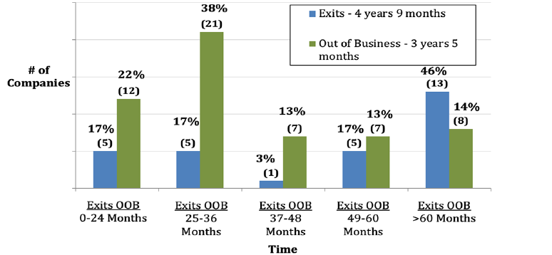
Typical Time to an Exit or
Going Out of Business

Slide 7
Early-stage startup investing
Some Key Risks
The Team
Companies are just past the ideation stage
Product-market fit may still be in the process of being refined
The companies are early in establishing a sales process
Financial models for years 3+ are speculative
On the other hand
Founding teams can be inspiring
The product offerings can be disruptive in the marketplace
It is rewarding to help young companies succeed
You can make a return while helping to make the world a better place

Slide 8
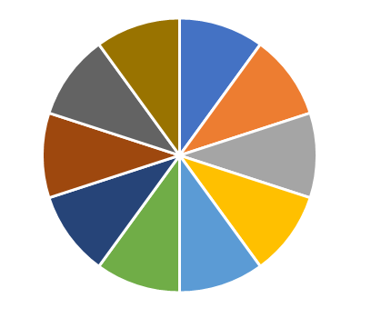
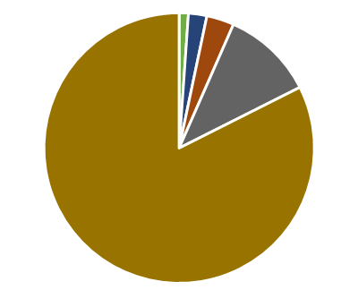
How is it possible to make a return?
One company will
provide a total return on your total investments
Make a bunch of investments
$
$

Slide 9
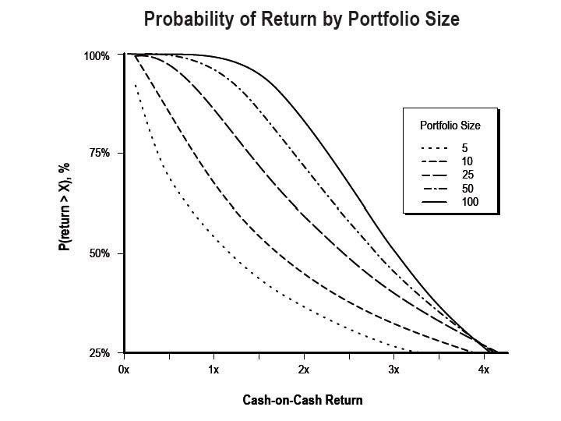
How Big a Portfolio?
5 10 25 100
Minimum of 100
20 is better

Slide 10
Decide how much to invest in total
What percent of your assets do
you want to put into this asset class,
and over what period of time?
Reserve funds for follow-on rounds.

Slide 11

Risk Factors.
What to look for

Slide 12
SWAN Evaluates Two Bottom Lines
Primary Consideration
Financial return to shareholders
Impact created by company’s primary business mission
Secondary Consideration
ESG (Environmental, Social, Governance), DEI & other socially responsible internal operations

Slide 13
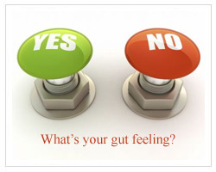

Improve Return Probability –
Do Due Diligence
✓
X
Analysis

Slide 14
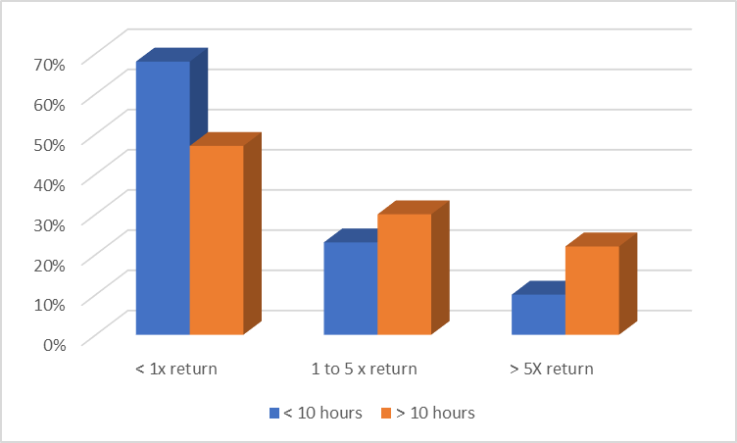
The Due Diligence Payoff

Slide 15

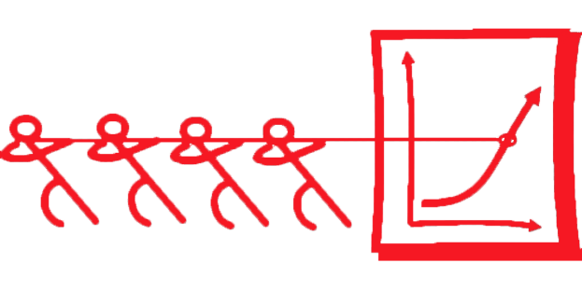
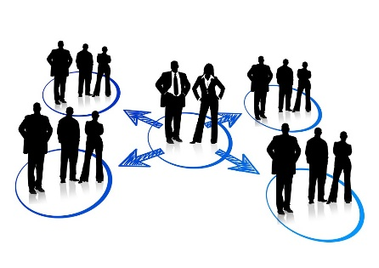
Approaches to Due Diligence
Harder
Easier
Go solo
  Prepare to spend
  a week
Be part of a team
  Our angels
  working together
Build upon diligence reports of others
  Maybe this is a syndication deal and another team has put in many hours

Slide 16
Due Diligence Considers
Team
Product, Technology & Advantages
Market Opportunity
Impact
Efficacy
Sales Approach
Finances
Deal Terms
Corporate Structure -Governance
Exit Opportunity

Slide 17

Team Validation –Job #1
Key Risks
How to assess
CEO lacks emotional maturity
CEO lacks experience in the company’s marketplace
CEO lacks startup experience
CEO is not full time at the company
Interacting with the CEO and C-Levels
  Typically, via zoom
Reference checks
  To direct references supplied
  Ideally to secondary references shared by direct references
  To former co-workers, board members, investors (LinkedIn is your friend)

Slide 18

Impact Risks
The company’s primary business mission is not clearly focused on delivering impact
  Is impact part of their basic DNA?
The CEO has no emotional
connection to the impact mission
The company’s home
page does not communicate
their impact mission

Slide 19

Impact risk – Uncertain Efficacy
What evidence is there that the company will effectively deliver significant impact?
A must-have-impact for beneficiaries?
Effective plan for acquiring beneficiaries?
Long-term competitive impact advantages?
  Higher adoption rates?
  More significant impact?
Direct impact?

Slide 20

Market Validation Risks
Risks
How to assess
Willingness and ability of customers pay for the solution
  Must-have vs. nice-to-have
  Person with must-have-need has budget available
  Unpaid pilots don’t establish willingness to pay
Lack of enough of those payers to generate enough revenue (big market)?
Phone calls with three to five payers
  Understand their pain point and budget
  Understand the sales channels they routinely use
Try the product out

Slide 21

Sales / Go-to-Market Risks
Lack of a credible sales operating plan for scaling to enough revenue to allow acquisition
  What type of marketing and sales organization and partners do they need (internal and external)?
  Not sufficient: the CEO is today talking to the CEO’s friends
No cost-effective way to connect with potential customers
  What is the cost of acquiring one incremental customer?
No compelling insights on:
  Customer retention rate
  Customer lifetime revenue

Slide 22

Product/Technology Risks
Product-market fit not yet demonstrated
Product not ready for pilots (hard tech) or sales (soft tech)
Development priorities not being driven by customer feedback
Industry specific
  SAAS: platform not scalable to large number of users
  Hardware: supply chain not established
  Medical/pharma: animal trials not complete

Slide 23

Competitive Risks
No significant competitive advantage today
No long-term, sustainable advantage => What keeps them successful for the seven years until acquisition?
  Critical mass of customers?
  Sales channel lock?
  Supply chain lock?
  IP/Copyright/trade secret?
Competitive analysis focused on feature comparisons rather than customer-benefits comparison

Slide 24

Financial Risks
Not raising enough in this round
  Companies take twice as much time and money to hit planned deliverables
Financial model not built on detailed assumptions
Company not spending enough on R&D and Marketing/Sales in out years
Revenue model not credible
  Must be bottom-up revenue plan based upon serviceable obtainable market (SOM)
  Number of customers willing to pay how much to solve a must-have solution
Red flags
  Very small revenue ramp => life-style business
  Incredibly large revenue ramp => team not credible

Slide 25

Corporate Governance Risks
Capitalization table risks
  Do disinterested parties have significant ownership?
  Does the CEO have the more ownership than other co-founders
  Is the post-funding option pool in the range of 15%?
Post-funding, will the post-funding board of directors contain only company representatives?
If this is a corporate spinout, who controls the cap table, C-levels or parent company?

Slide 26
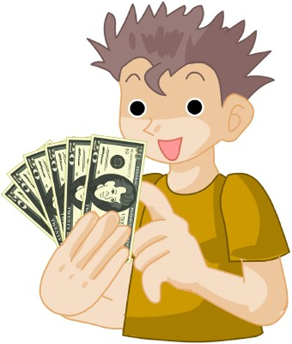
Investor Return Risks
With this investment, can the company achieve a business result that significantly increases valuation at the next round?
Is the company able to identify acquisition comparables?
Is our post-funding percent ownership consistent with typical models?
  E.g., will pre-seed investor have ~15% ownership
Huge amount of funding is required for an exit

Slide 27
Investment Deal Terms
More
Company
Friendly
More
Investor
Friendly
Stronger company?
Easier to syndicate?
Higher valuation cap or pre-money
SAFE note?
If we lead, we can set terms
Convertible note or preferred stock
Higher risk of future down round?
Lower valuation cap or pre-money
Deal terms and instruments are covered in more detail in the 202 webinar

Slide 28

experience
Portland Seed Fund is an early-stage venture fund in Portland and has made 70 investments.
They analyzed what parameters best predicted a high investment ROI
By far, the best predictor of high ROI was company-friendly terms
  Companies with the best products, the best teams and large markets can demand the best deal terms

Slide 29

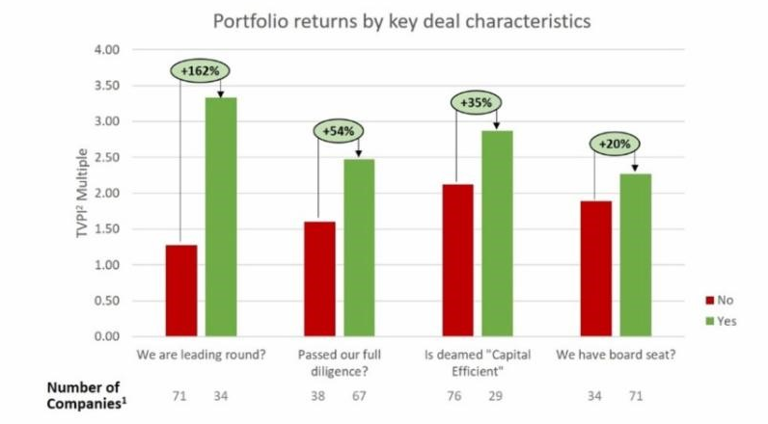
findings
Measured based upon valuation increase.
Leading round = negotiated the terms.
Capital Efficient = needs less than $5M total.

Slide 30

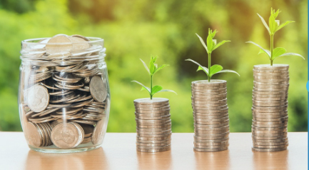

Additional Webinars
Angel Investing 101
  The Angel Experience: What is an Angel Investor? What motivates Angels? What are examples of typical Angel investments? How does the SWAN operate?
Angel Investing 202
  The Mechanics of Investments: Investment instruments, company valuations, dilution across rounds, post-investment activities, and tax considerations
Angel Investing 203
  Measuring Impact and Results: A Discussion of Metrics and Tools, and examples of SWAN impact assessments

Slide 31
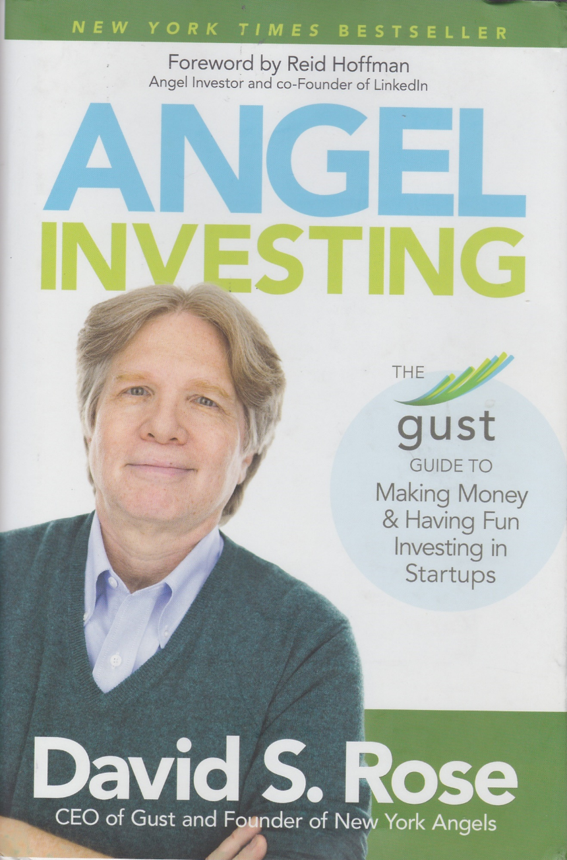
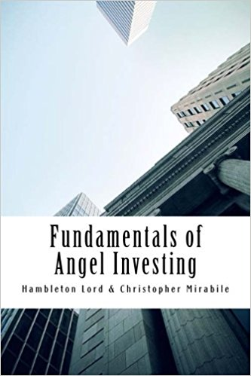
Good Resources

Slide 32
Webinar Feedback
Any final questions?
What was most helpful?
What was less interesting?
What would you like to learn more about?

